Slide 1
Pharmacokinetic & Pharmacodynamic Changes with Aging
Susan Kent, PharmD, CGP
Advanced Clinical Pharmacokinetics
Spring 2014
Office: Room 524
susan.kent@temple.edu

Slide 2
Learning Objectives
Discuss aging epidemiology and the impact of demographic changes to the US population.
Discuss specific pharmacokinetic and pharmacodynamic changes in the elderly and their clinical significance.

Slide 3
Learning Objectives
Summarize physiologic changes associated with aging and the potential impact on pharmacotherapy.
Identify problematic drug therapy in elderly patients and suggest strategies for addressing these issues.

Slide 4
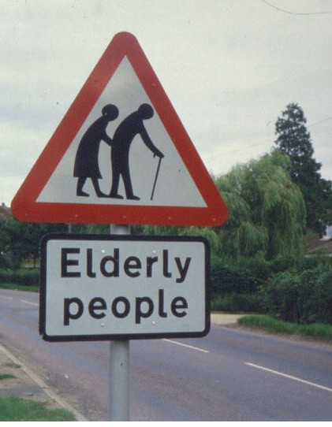
Aging
Elderly are arbitrarily defined as those ≥ 65 yo
Mechanism of aging is unknown
Damage of macromolecules by background radiation?
Genetic predetermination?
Multiple co-morbidities
Numerous biologic changes

Slide 5
How old is old?
65-74 (young old)
75-84 (middle old)
> 85 (oldest old)
1 in 4 adults in this category by 2050
www.americangeriatrics.org

Slide 6

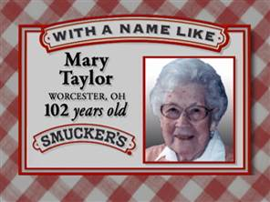
Aging Demographics
65 and older: 89 million strong by 2050
2011: the first baby boomers turned 65
Older adults ~12% of the US population
30% of all prescription medications
25% of all OTC medications
Average number of medications in ambulatory adults 65+
40% use 5 or more meds
12% use 10 or more meds
67.2% of older NH residents
take 9+ meds/day

Slide 7
Unique Characteristics of the Elderly
Population – Booming!
Health
Institutionalization
Drug use
Drug effects

Slide 8
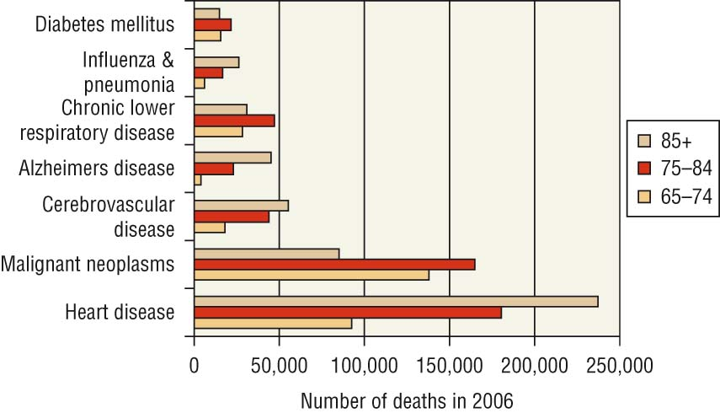
FIGURE 11-1. Leading Causes of Death in 2006, by age group. (Data from Centers for Disease Control and Prevention, National Center for Injury Prevention and Control, 2006. http://webappa.cdc.gov/sasweb/ncipc/leadcaus10.html.).

Slide 9
Relationship Between ADE and Co-morbidity
60
50
40
30
20
10
p< 0.026
r= 0.81
Risk of ADE (%)
0 1 2 3 4 5 6 7
Number of Diseases
Grymonpre RE et al. J Am Geriatr Soc. 1988; 36: 1092-98.

Slide 10
Pharmacokinetics vs. Pharmacodynamics
PK - what the body does to the drug
Absorption
Distribution
Metabolism
Elimination
PD - what the drug does to the body
Clinical effects

Slide 11
Alterations in Absorption
Most drugs are absorbed by passive diffusion
Oral absorption of meds can be delayed
Delayed gastric emptying
Decreased GI blood flow
Increased gastric pH (calcium salts)
Minimal difference in absorption with chronic administration

Slide 12
Alterations in Absorption
Absorption across other barriers
Skin
Reduced blood flow to the skin (↓ rate)
Muscle
Erratic absorption from IM injections
Other medications
Antacids, MOM, proton pump inhibitors, H₂ blockers
Rate of absorption may be delayed, but not the extent of absorption

Slide 13
Alterations in Distribution
Decrease in total body water
↓ V_{d} of water-soluble medications
↑ plasma concentrations
Gentamicin, tobramycin
Decrease in lean body mass
↓ V_{d} for meds that distribute into lean muscle
↑ plasma concentrations
Digoxin

Slide 14
Alterations in Distribution
Increase in total body fat
↑ V_{d} of lipid-soluble medications
↑ t_{1/2} of lipid-soluble medications
Lipophilic meds should be used at reduced doses or ↑ intervals
Diazepam
Half life in younger adult: 24-48 hours
Half life in elderly adult: > 90 hours

Slide 15
Alterations in Distribution
Protein binding
May or may not be changed in the elderly
Decrease in serum albumin
Influenced primarily by disease and nutrition
↑ free-fraction of highly protein bound meds
Phenytoin and warfarin: 99% protein bound

Slide 16
Hepatic Metabolism
↓ in hepatic blood flow and hepatic mass
High extraction ratio medications
Less drug metabolized → increased bioavailability in elderly patients → dose cautiously!
Verapamil, propranolol, morphine
Cytochrome P450 isoenzyme system
Conflicting data

Slide 17
Hepatic Metabolism
Phase I Reactions
Oxidation, reduction, hydrolysis
Decline in Phase 1 reactions with aging
Risk of accumulation of active metabolites and toxicity
Diazepam, alprazolam, theophylline, warfarin, diltiazem, amitriptyline
Phase II Reactions – Conjugation
Acetylation, glucuronidation, sulfation
Phase II reactions typically unaffected by age
Acetaminophen, isoniazid, naproxen, Oxazepam, Temazepam, Lorazepam

Slide 18
Renal Elimination
Decreases in:
Glomerular filtration rate (GFR)
GFR decreases ~ 1% for every year of age > 20
Renal blood flow
Decreases by 1% per year after age 50
Renal mass
Decreases by about 10-20% from age 40-80
Renal tubule secretory function
Can affect creatinine elimination
Result is ↓ clearance and ↑ half-life of renally eliminated drugs

Slide 19
Renal Elimination
Creatinine clearance (Cl_{cr}) used to guide drug dosing
Important to determine estimate of Cl_{cr} as many drugs are eliminated via the renal route
Measurement of Scr in the elderly may be misleading
May overestimate kidney function

Slide 20
Renal Elimination Clinical Controversy
Cockcroft – Gault
(140-age) (wt) (x 0.85)
72 x SCr if female
May overestimate GFR due to decreased lean muscle mass
?? Round SCr up to 1.0 mg/dL

Slide 21
Renal Elimination
Example: 70 YO, 50 kg frail woman with a SCr of 0.5 mg/dL
(140-70)(50) x 0.85
(72)(0.5)
= 83 mL/min
(140-70)(50) x 0.85
(72)(1)
= 41 mL/min

Slide 22
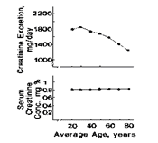
Relationship of Age to Scr and Creatinine Excretion

Slide 23
Key Points – Scr, Cl_{cr}
Cockcroft-Gault equation continues to be primary method for calculating estimated Cl_{cr}
Estimating doses and dosing intervals for renally eliminated medications should always take into account individual patient characteristics
Round Scr to 1 mg/dL ?
Use clinical judgment rather than a specific rule

Slide 24
Clinical Toxicity Associated with Renal Impairment
Agent
Digoxin
Aminoglycosides
Imipenem
Amantadine
Allopurinol
Lithium
H₂ Antagonists
Metformin
Toxicity
Cardiac, CNS, GI
Renal, Ototoxicity
Seizures
CNS
Derm, Renal, Hepatic
CNS, Renal
CNS
Lactic acidosis

Slide 25
Metabolite Accumulation in Renal Impairment
Agent | Metabolite | Effect
Meperidine Allopurinol Morphine Propoxyphene Procainamide | Normeperidine Oxypurinol Morphine-6-glucuronide Norpropoxyphene N-acetyl procainamide | Seizures Rash Respiratory depression CNS/respiratory depression Sinus bradycardia

Slide 26
Summary of Pharmacokinetic Changes
Process | Changes | Effects
Absorption | ↔ in passive absorption No change in F for most drugs - Delayed gastric emptying | - Change in GI emptying time may decrease the rate, but not the extent of absorption
Distribution | - ↓ Vd water soluble drugs - ↓ Protein binding (albumin) - ↑ Vd fat soluble drugs | ↑ plasma concentration ↑ free fraction/toxicity Prolonged half life
Metabolism | - ↓ phase I reactions - ↔ phase II reactions | ↑ toxicity Potentially no effect
Elimination | - ↓ renal functional capacity | - ↑ toxicity

Slide 27
Pharmacodynamic Changes
Elderly exhibit changes in drug response dynamically as well
Possible mechanisms
# of receptors in target organ
Receptor affinity
Postreceptor alterations
Homeostasis impairment

Slide 28
Age Related Pharmacodynamic Changes - CV
Cardiovascular System
As catecholamine levels ↑, down-regulation of cardiac beta-1-adrenergic receptors occurs
Decreased sensitivity of CV system to beta-1-adrenergic agents
Blunted effect of beta-blockers in elderly patients

Slide 29
Age Related Pharmacodynamic Changes - CV
Decreased baroreceptor sensitivity
Orthostatic hypotension
Diminished capacity to react to blood pressure drop when rising
Isolated systolic hypertension (>140/<90)
Risk of torsades de pointes
Type of ventricular tachycardia
↑ sensitivity to meds that prolong QT interval

Slide 30
Age Related Pharmacodynamic Changes - CNS
Changes in blood brain barrier permeability
Increased sensitivity to psychoactive meds
BZDs, opiates, psychotropics
↓ Dopaminergic neurons and receptors
Susceptibility to EPS and movement disorders
Antipsychotics, metoclopramide

Slide 31
Age Related Pharmacodynamic Changes - CNS
Decreased cholinergic neurons
↑ Sensitivity to anticholinergic medications
First-generation antihistamines
TCAs
Antipsychotics

Slide 32
Age Related Pharmacodynamic Changes
Warfarin
Increased response/sensitivity
Elderly require lower plasma concentration to inhibit clotting factor production
Begin with lower doses & avoid overshooting INR goals

Slide 33
Physiologic Changes
Regulatory center homeostasis
Smaller neurotransmitter reserves
Reduced ability to respond to stressors
Less able to adapt to changes & regulate BG, blood pH, HR, BP
Gait, balance, body temp & bowel/bladder function can also be affected

Slide 34
Clinical Geriatrics Increased Adverse Effects
Hypotension
Anticholinergic side effects
Sedation
Delirium
Fall and fracture risk
Bleeding or hemorrhage events

Slide 35
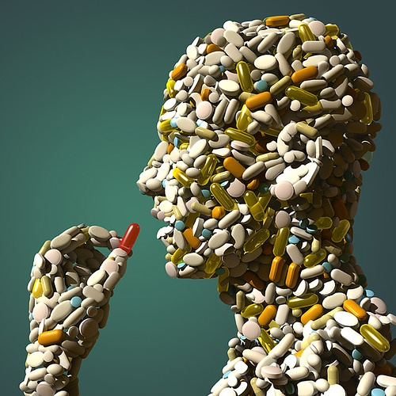
Polypharmacy
Use of multiple medications
Administration of unnecessary medications

Slide 36
Relationship Between ADE and Number of Medications
60
50
40
30
20
10
0
p<0.001
r=0.77
Risk of ADE %
1-2 3-4 5-6 7-8 9-10 11-12 13-14 15-16
Number of Medications
Grymonpre RE et al. J Am Geriatr Soc. 1988; 36: 1092-98.

Slide 37
Medication Usage
Community-dwelling older adults
Two to ten Rx and non-Rx meds daily
49% use at least one dietary supplement
Institutionalized older adults
Average of 6.69 routine medications
27.1% → 9 or more meds on regular basis
Polypharmacy
Incidence ranges from 44-59%

Slide 38
AGS Beers Criteria
Originally published in 1991 by MH Beers
2012: 11-member interdisciplinary expert panel
IDs potentially inappropriate medications (PIMs)
Ineffective or pose unnecessarily high risk and
Safer alternative is available
53 medications or classes of medications:
PIMs and classes to avoid in older adults
PIMs to avoid in older adults with certain diseases
Medications to be used with caution in older adults

Slide 39
Atypical Presentation in Older Adults
Disease | Presentation
AMI | Only ~50% present with CP. Older adults generally present with weakness, confusion, syncope, & abdominal pain. EKG changes similar to younger adults.
CHF | Instead of dyspnea, the older adult may present with hypoxic symptoms, lethargy, restlessness, & confusion.
GI bleed | Although mortality rate is ~10%, presenting sx are nonspecific, ranging from altered mental status to syncope with hemodynamic collapse. Abdominal pain is often absent.

Slide 40
Atypical Presentation in Older Adults
Disease | Presentation
URI | Older patients typically present with lethargy, confusion, anorexia & decompensation of a preexisting medical condition. Fever, chills, & a productive cough may or may not be present.
UTI | Dysuria, fever, & flank pain may be absent. More commonly, older adults present with incontinence, confusion, abdominal pain, N/V & azotemia.

Slide 41
Considerations for Effective Pharmacotherapy in the Elderly
Evidence-based
Effectiveness
Safety
Dose/renal function
Complexity of drug regimens
Cost
Adherence

Slide 42
Geriatric Principles of Treatment
Start low, go slow
Monitor for adverse effects
Discontinue unnecessary medications
Frequently reassess need for medications
Avoid polypharmacy
Review medications for appropriateness
Beers criteria and others available

Slide 43
Geriatric Principles of Treatment
Be aware of PK/PD changes
Renal & hepatic adjustment
Investigate new symptoms
Evaluate adherence
Involve family/support system
Keep vaccinations updated

Slide 44
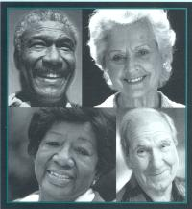
Wrinkles should merely indicate where smiles have been. -Mark Twain

